Slide 1
7th Grade Fall Semester Review 2011

Slide 2
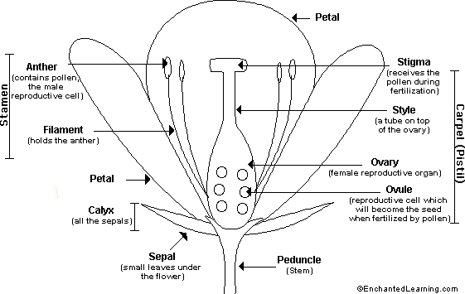
Pollination – sexual or asexual

Slide 3
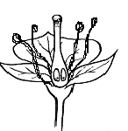
Pollination
POLLEN

Slide 4
Why do flowers have bright petals?
Overall brightly colored flower petals assist in attracting insects, birds and small mammals to the flower for pollination. Colored petals and nectar are normally used in conjunction - the petals as the attractant and the nectar as the "reward".

Slide 5
Natural selection definition
The traits that help an organism survive in a particular environment are “selected” in natural selection
Evolution means change over time.

Slide 6
How does natural selection work
1. Organisms vary and these variations (genes) are inherited by their offspring.
2. Organisms produce more offspring than can possibly survive in nature.
Those offspring that do survive are best adapted to their environment and will pass their genes on to their offspring.
The result is, over time, populations of organisms become better adapted to their environment by this process of natural selection which increases their survival rate .

Slide 7
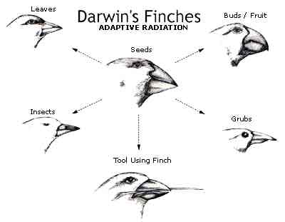
What did darwin discover about finches on the galapagos islands?

Slide 8

What is budding
Parent organism divides into two unequal parts.
The new organism is created as a smaller out growth or bud on the outside of the parent.
Buds will brake off and live independently or remain attached and form a colony.
Hydra is example; yeast buds also

Slide 9

What is regeneration
The ability to re-grow lost or damaged body parts. Hydra, planaria, starfish, and earthworm
More complex animals less able to re-grow parts. Crab can re-grow a claw. Some reptiles can re-grow a tail.
Most mammals can repair damaged tissue but can not re-grow missing parts.

Slide 10

What is fission
simplest form of asexual reproduction.
Parent organism divides into two approximately equal parts.
Each daughter cell becomes a new individual.
Bacteria and protozoa

Slide 11
What is sexual reproduction
To ensure survival of the species
    To produce egg and sperm cells
    To nurture the developing offspring
    To produce hormones
  maintain a state of homeostasis
Male Functions
  To produce, sperm
  organ- testes
Female Functions
  The fertilization of an egg by a sperm, occurs in the fallopian tubes
  Organ- Ovaries

Slide 12
What is asexual reproduction
a new organism is produced from one parent and has DNA identical to the parent
Yeast (budding)
Planaria
Leaf cuttings/runners
Amoeba (binary fission)
Starfish( regeneration)

Slide 13
What type of offspring do asexual parents produce?
Uniform
Look exactly like parents

Slide 14
What are examples of inherited traits?
you may inherit a genetic disease or condition, such as breast cancer or heart attacks
hair color
eye color
height

Slide 15
What is selective breeding?
How man has changed the traits of organisms for preference.
Dogs have been breed to be friendly
Cats which are small and not aggressive
Cows to produce more milk
Horses for speed
Gold-colored fish

Slide 16
If you want only recessive traits what should you cross? (punnett square not necessary)
Recessive traits are written all lower case: rr
So the parents would have to be recessive too

Slide 17
What is the relationship between Dna, nucleus, gene, chromosome
Cell
  Nucleus
    DNA
      Chromosome
        Gene

Slide 18
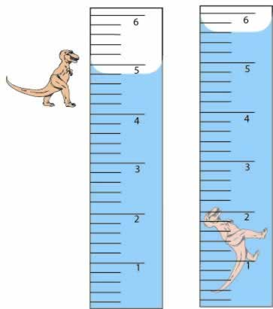
Read volume of an irregular shaped object
Volume is the space that an object occupies
Irregular object: dinosaur
Water displacement
End= 5.6 ml
Beginning= 4.8ml
Difference= .8 ml

Slide 19
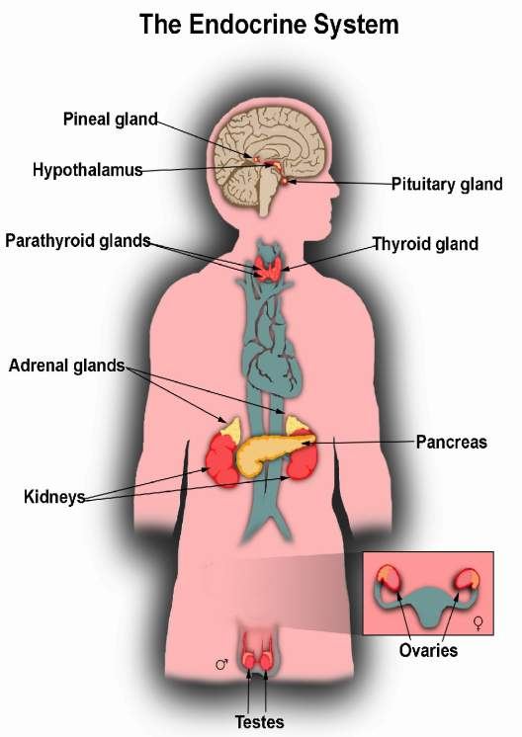
How do endocrine and reproductive systems relate to one another?
The Endocrine Glands are the organs of the Endocrine System.
They produce and secrete (release) Hormones to the reproductive organs.
.

Slide 20
How are traits inherited?
Inherited traits come from our genes, which are unique to each person, which are all passed on from your parents.

Slide 21
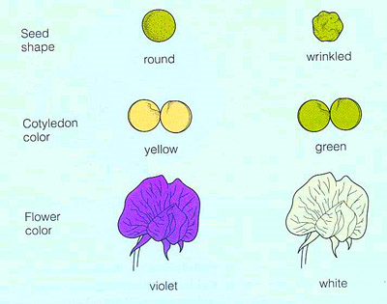
What is a phenotype?
Phenotype- the physical appearance of a trait in an organism

Slide 22
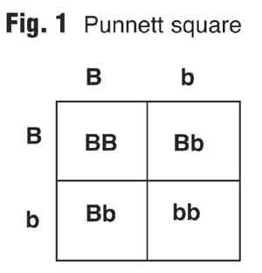
What is a genotype?
Genotype- the genes of an organism for one specific trait

Slide 23
What is homozygous?
Homozygous= two alleles that are the same for a trait (Pure)

Slide 24
What is heterozygous?
Heterozygous= two different alleles for a trait (Hybrid)

Slide 25
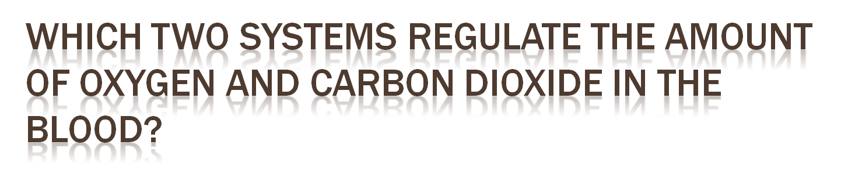
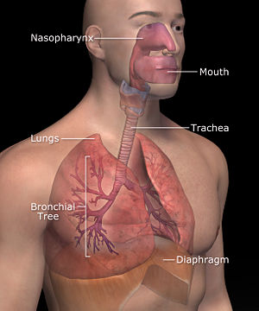
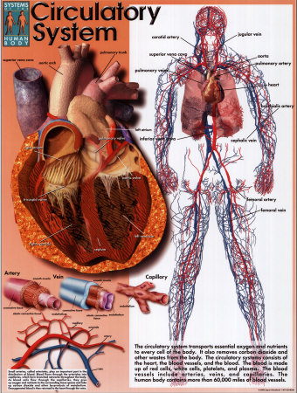
the system of organs involved in the exchange of carbon dioxide and oxygen
between an organism and its environment.
The bodily system consisting of the heart, blood vessels, and blood that circulates blood throughout the body, delivers nutrients and other essential materials to cells, and removes waste products

Slide 26
What are the functions of :
Sperm- fertilize egg
Egg- fertilized to make a zygote
Ovary- produces eggs
Testes- produces sperm
Ovule- matures into a fetus
Semen- carries sperm to egg
Testosterone- stimulates production of sperm

Slide 27
Microscope use
Tool used to see microscopic objects too small to be seen with the eye: cells, bacteria, protozoa

Slide 28
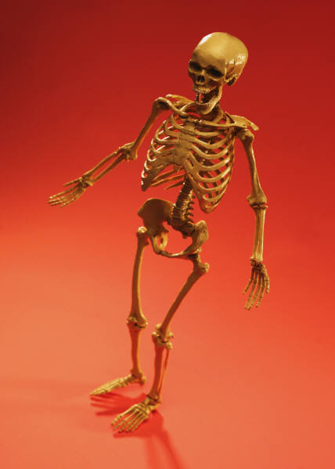
Systems directly related to walking
The skeleton
is connected
to the ___________
so you can
move
MUSCLES

Slide 29
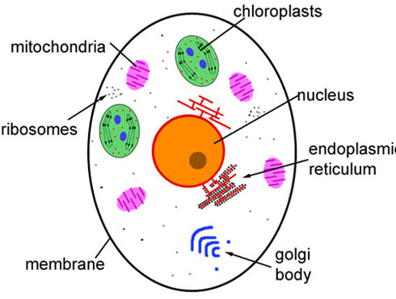
Function of these cell parts
Organelles that release energy from food = powerhouse
Mitochondria
Cell wall
Cell membrane
Chloroplast
Lysosome
Green organelles that make food- only in plant cells
protects the cell and gives shape- only in plant cells
Outer covering, protective layer around ALL cell
Removes cell waste just like our kidneys

Slide 30
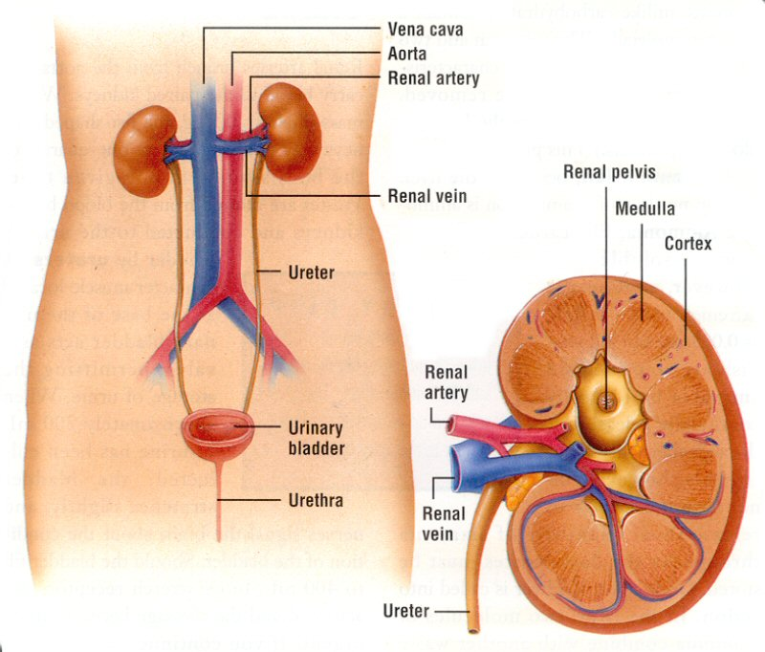
Function of the kidneys
The systems that excrete wastes from the
body

Slide 31
Function of the parts:
Thin muscle used to push the lungs upward during exhaling
Diaphragm
Bronchial tubes
Epiglottis
Alveoli
Two passageways from the trachea to the lungs
Flap of skin that prevents food from entering the trachea
tiny, delicate air sacs deep within the lungs where the gas/blood
exchange occurs

Slide 32
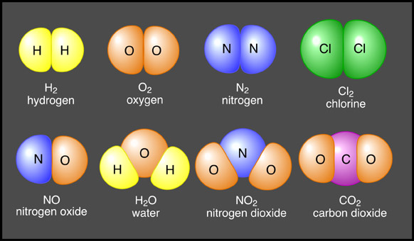
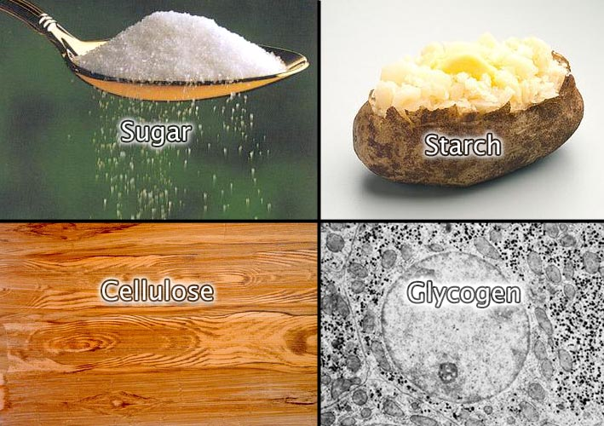
Examples of organic compounds
Organic Compounds contain carbon and are usually associated with living things.

Slide 33
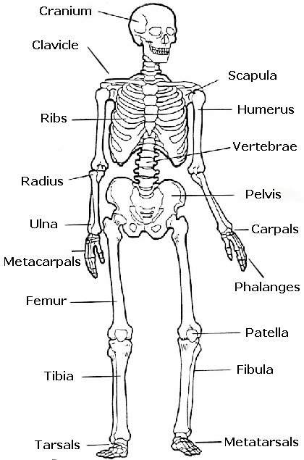
What and where are ball and socket joints
        Ball-and-socket joints- formed when a rounded head of one bone fits into the rounded cavity of an jointed bone.

Slide 34
Safety rules when using chemicals in a lab
When anything spills in the lab, the teacher should be notified right away.
The open end of a test tube should never be pointed toward you or anyone else.
Long hair should be tied back when working with chemicals in a lab.
Clean up is everyone’s responsibility.
Dispose in chemicals safely.

Slide 35
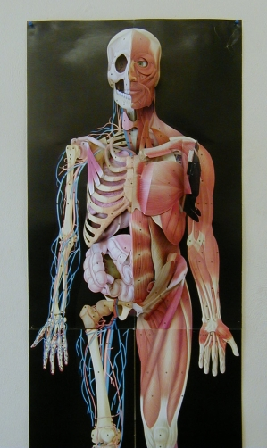
Muscles types
Voluntary muscles- muscles that you are able to control
  Examples are leg and arm muscles
Involuntary Muscles- you can not move them consciously. They just keep working
  Examples- heart

Slide 36
Describe a stimulus and response
stimulus: anything that causes an organism to react. (starts)
  Food poisoning occurs when you swallow food or water that contains bacteria, parasites, viruses, or toxins made by these germs.
response: a reaction to a stimulus.
  vomitting

Slide 37
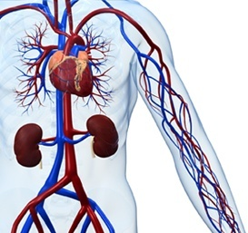
Function of blood vessels and their description
Arteries are pipelines that generally carry blood away from the heart. They carry oxygen-rich blood. (red)
Veins generally carry oxygen-poor blood back to the heart from the rest of the body. (blue)
Capillaries are microscopic blood vessels that connect arteries to veins. They are where oxygen & waste exchange occur.

Slide 38
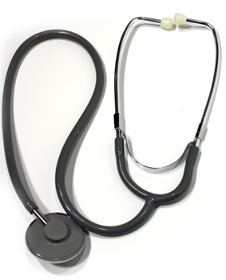
Describe what blood pressure is
The force of the blood on the walls of the blood vessels.

Slide 39

Energy required for peristalsis
The wavelike muscular contractions
of the esophagus by which contents are physically forced down from the mouth to the stomach.

Slide 40
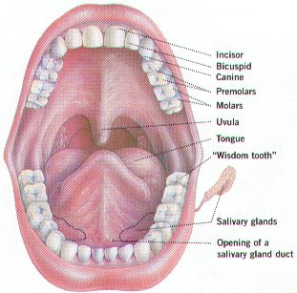
Energy transformation in mouth during digestion
food is physically broken down by the teeth
transformed
Food is chemically broken down by saliva
transformed
HEAT!!!

Slide 41
Why do starches begin to taste sweet in the mouth…what’s happening?
where there is a chemical reaction, a new substance is formed
Starches sugars

Slide 42
Calculate Density
If density is the measurement of mass in a certain volume, what tools would you use
  If it was a liquid? Triple beam balance and a graduated cylinder= g/ml
  If it was a solid object? Triple beam balance and a metric ruler (l x w x h)= g/cm³

Slide 43
Describe when work is done and when it is not done (refer to a spring scale and a ramp)
Calculate the work needed push a box up a 5m ramp with a force of 25 N on spring scale.
  W= f d
  W= 25 N x 5 m
  W= 125 joules
Calculate the work done to lift the box with 25 N.
  W= f d
  W= 25 N x 0
  W= 0

Slide 44
Percent chance of having a dominate or recessive trait using a punnett square
Dominant
¾= 75%
Recessive
1/4= 25%

Slide 45
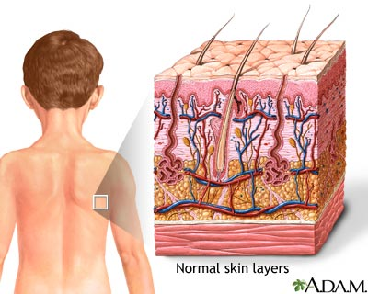
Relate the integumentary system to a house
House | Integumentary System | Digestive | Excretory
Bricks and roof
Plumbing pipes
Doors and windows
Electrical wires
Thermostat

Slide 46
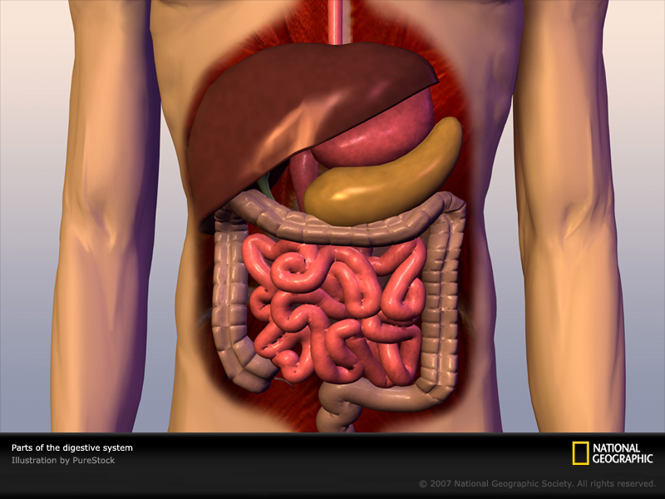
Relate the digestive system to a house
House | Digestive System | Digestive | Excretory
Bricks and roof
Plumbing pipes
Doors and windows
Electrical wires
Thermostat

Slide 47
Relate the excretory system to a house
House | Excretory System | Digestive | Excretory
Bricks and roof
Plumbing pipes
Doors and windows
Electrical wires
Garbage Disposal

